Slide 1
Theory of Computation
Lecture 10
CFG & PDA (Cont’d)
Dr. Samar Hesham
Department of Computer Science
Faculty of Computers and AI
Cairo University
Egypt

Slide 2
Syllabus and Terminologies
Regular Languages .. Regular Sets
REs (Regular Expressions)
FSMs (or FSA/FA) … Finite State Machines/Automata
DFSM/DFA vs. NDFSM/NFA … Deterministic vs. Non-deterministic FSM
Comparison and conversion
Examples & Closure Operations
Context Free Languages
CFGs … Context Free Grammars
PDA … Push Down Automata
Some applications
Turing Machine

Slide 3
The States
Input
symbol
Pop
symbol
Push
symbol

Slide 4
a^{n}b^{n}: with Stack Check
PDA :

Slide 5
Basic Idea:
Push the a’s
on the stack
2. Match the b’s on input
with a’s on stack
3. Match
found

Slide 6
Execution Example:
Time 0
Input
Stack
current
state

Slide 7
Time 1
Input
Stack

Slide 8
Time 2
Input
Stack

Slide 9
Time 3
Input
Stack

Slide 10
Time 4
Input
Stack

Slide 11
Time 5
Input
Stack

Slide 12
Time 6
Input
Stack

Slide 13
Time 7
Input
Stack

Slide 14
Time 8
Input
Stack
accept

Slide 15
Rejection Example:
Time 0
Input
Stack
current
state

Slide 16
Rejection Example:
Time 1
Input
Stack
current
state

Slide 17
Rejection Example:
Time 2
Input
Stack
current
state

Slide 18
Rejection Example:
Time 3
Input
Stack
current
state

Slide 19
Rejection Example:
Time 4
Input
Stack
current
state

Slide 20
Rejection Example:
Time 4
Input
Stack
reject
current
state

Slide 21
There is no accepting computation for
The string is rejected by the PDA

Slide 23
Palindromes with stack checking
PDA :

Slide 24
Basic Idea:
Push v
on stack
3. Match on input
with v on stack
2. Guess
middle
of input
4. Match
found

Slide 25
Execution Example:
Time 0
Input
Stack

Slide 26
Time 1
Input
Stack

Slide 27
Time 2
Input
Stack

Slide 28
Time 3
Input
Guess the middle
of string
Stack

Slide 29
Time 4
Input
Stack

Slide 30
Time 5
Input
Stack

Slide 31
Time 6
Input
Stack
accept

Slide 32
Rejection Example:
Time 0
Input
Stack

Slide 33
Time 1
Input
Stack

Slide 34
Time 2
Input
Stack

Slide 35
Time 3
Input
Guess the middle
of string
Stack

Slide 36
Time 4
Input
Stack

Slide 37
Time 5
Input
There is no possible transition.
Input is not consumed
Stack

Slide 38
Another computation on same string:
Input
Time 0
Stack

Slide 39
Time 1
Input
Stack

Slide 40
Time 2
Input
Stack

Slide 41
Time 3
Input
Stack

Slide 42
Time 4
Input
Stack

Slide 43
Time 5
Input
No accept state
is reached
Stack

Slide 44
There is no computation
that accepts string

Slide 46
Another PDA example
PDA

Slide 47
Execution Example:
Time 0
Input
Stack
current
state

Slide 48
Time 1
Input
Stack

Slide 49

Time 3
Input
Stack

Slide 50
Time 4
Input
Stack

Slide 51
Time 5
Input
Stack

Slide 52
Time 6
Input
Stack

Slide 53
Time 7
Input
Stack

Slide 54
Time 8
Input
Stack
accept

Slide 56
Formal Definition
Pushdown Automaton (PDA)
Accept
states
States
Input
alphabet
Stack
start
symbol
Transition
function
Initial
state
Stack
alphabet

Slide 57
Types of PDA Transitions
Two types of PDA transitions:
δ(q, a, z) = {(p₁,γ₁), (p₂,γ₂),…, (p_{m},γ_{m})}
Current state is q
Current input symbol is a
Symbol currently on top of the stack z
Move to state p_{i} from q
Replace z with γ_{i} on the stack (leftmost symbol on top)
Move the input head to the next input symbol
:
p₁
a/z/ γ₁
q
a/z/ γ₂
p₂
a/z/ γ_{m}
p_{m}

Slide 58
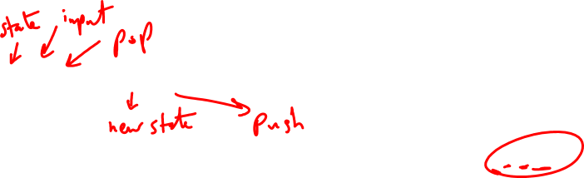
Types of PDA Transitions
Two types of PDA transitions:
δ(q, ε, z) = {(p₁,γ₁), (p₂,γ₂),…, (p_{m},γ_{m})}
Current state is q
Current input symbol is not considered
Symbol currently on top of the stack z
Move to state p_{i} from q
Replace z with γ_{i} on the stack (leftmost symbol on top)
No input symbol is read
:
p₁
ε/z/ γ₁
q
ε/z/ γ₂
p₂
ε/z/ γ_{m}
p_{m}

Slide 59
Transition function:

Slide 60
Transition function:

Slide 61
Example: 0^{n}1^{n}, n>=0
M = ({q₁, q₂}, {0, 1}, {L, #}, δ, q₁, #, Ø)
δ:
(1) δ(q₁, 0, #) = {(q₁, L#)} // stack order: L on top, then # below
(2) δ(q₁, 1, #) = Ø // illegal, string rejected, When will it happen?
(3) δ(q₁, 0, L) = {(q₁, LL)}
(4) δ(q₁, 1, L) = {(q₂, ε)}
(5) δ(q₂, 1, L) = {(q₂, ε)}
(6) δ(q₂, ε, #) = {(q₂, ε)} // if ε read & stack hits bottom, accept
(7) δ(q₂, ε, L) = Ø // illegal, string rejected
(8) δ(q₁, ε, #) = {(q₂, ε)} // n=0, accept
Goal: (acceptance)
Read the entire input string
Terminate with an empty stack
Informally, a string is accepted if there exists a computation that uses up all the input and leaves the stack empty.

Slide 62
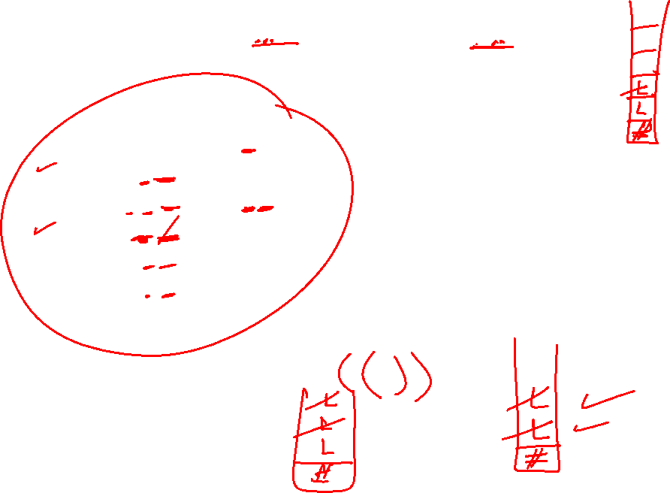
Example: balanced parentheses,
e.g. in-language: ((())()), or (())(), but not-in-language: ((())
M = ({q₁}, {“(“, “)”}, {L, #}, δ, q₁, #, Ø)
δ:
(1) δ(q₁, (, #) = {(q₁, L#)} // stack order: L-on top-then- # lower
(2) δ(q₁, ), #) = Ø // illegal, string rejected
(3) δ(q₁, (, L) = {(q₁, LL)}
(4) δ(q₁, ), L) = {(q₁, ε)}
(5) δ(q₁, ε, #) = {(q₁, ε)} // if ε read & stack hits bottom, accept
(6) δ(q₁, ε, L) = Ø // illegal, string rejected
// What does it mean? When will it happen?
Goal: (acceptance)
Read the entire input string
Terminate with an empty stack

Slide 63
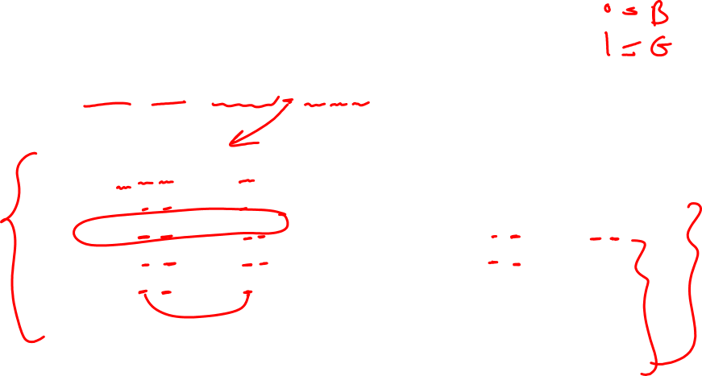
Example PDA #2: For the language {x | x = ww^{r} and w in {0,1}*}
Note: length |x| is even
M = ({q₁, q₂}, {0, 1}, {#, B, G}, δ, q₁, #, Ø)
δ:
(1) δ(q₁, 0, #) = {(q₁, B#)}
(2) δ(q₁, 1, #) = {(q₁, G#)}
(3) δ(q₁, 0, B) = {(q₁, BB), (q₂, ε)} (6) δ(q₁, 1, G) = {(q₁, GG), (q₂, ε)}
(4) δ(q₁, 0, G) = {(q₁, BG)} (7) δ(q₂, 0, B) = {(q₂, ε)}
(5) δ(q₁, 1, B) = {(q₁, GB)} (8) δ(q₂, 1, G) = {(q₂, ε)}
(9) δ(q₁, ε, #) = {(q₂, #)}
(10) δ(q₂, ε, #) = {(q₂, ε)}
Notes:
Rules #3 and #6 are non-deterministic: two options each
Rules #9 and #10 are used to pop the final stack symbol off at the end of a computation.

Slide 64
Example Computation:
(1) δ(q₁, 0, #) = {(q₁, B#)} (6) δ(q₁, 1, G) = {(q₁, GG), (q₂, ε)}
(2) δ(q₁, 1, #) = {(q₁, G#)} (7) δ(q₂, 0, B) = {(q₂, ε)}
(3) δ(q₁, 0, B) = {(q₁, BB), (q₂, ε)} (8) δ(q₂, 1, G) = {(q₂, ε)}
(4) δ(q₁, 0, G) = {(q₁, BG)} (9) δ(q₁, ε, #) = {(q₂, ε)}
(5) δ(q₁, 1, B) = {(q₁, GB)} (10) δ(q₂, ε, #) = {(q₂, ε)}
State Input Stack Rule Applied Rules Applicable
q₁ 000000 # (1), (9)
q₁ 00000 B# (1) (3), both options
q₁ 0000 BB# (3) option #1 (3), both options
q₁ 000 BBB# (3) option #1 (3), both options
q₂ 00 BB# (3) option #2 (7)
q₂ 0 B# (7) (7)
q₂ ε # (7) (10)
q₂ ε ε (10)
Notes:
What is rule #10 used for – emptying the stack.
What is rule #9 used for – emptying the stack.
Why do rules #3 and #6 have options – you don’t know where the middle of the string is.
Why don’t rules #4 and #5 have similar options – suppose rule #4 had option (q₂, λ). Then 0100 would be accepted.

Slide 65
0011
• (q1, 0 011, #) |-
(q1, 0 11, L#) |-
(q1, 1 1, LL#) |-
(q2, 1, L#) |-
(q2, e, #) |-
(q2, e, e): accept
• 011
• (q1, 0 11, #) |-
(q1, 1 1, L#) |-
(q2, 1, #) |-
Ø : reject

Slide 66
Instantaneous Description
Current
state
Current
stack
contents
Remaining
input
At any time t_{i}

Slide 67
Example:
Instantaneous Description
Time 4:
Input
Stack

Slide 68
Example:
Instantaneous Description
Time 5:
Input
Stack

Slide 69
We write:
Time 4
Time 5

Slide 70
A computation:

Slide 71
For convenience we write:

Slide 72
Language of PDA
Language accepted by PDA :
Initial state
Accept state

Slide 73
Example:
PDA :

Slide 74
PDA :

Slide 75
Therefore:
PDA :

Slide 76
PDA versus CFLs
A language L is context-free if and only if there is a pushdown automata M that recognizes L.
Two step proof:
Given a CFG G, construct a PDA M_{G}
2) Given a PDA M, make a CFG G_{M}

Slide 77
Theorem:
Context-Free
Languages
(Grammars)
Languages
Accepted by
PDAs

Slide 78
Proof - Step 1:
Context-Free
Languages
(Grammars)
Languages
Accepted by
PDAs
Convert any context-free grammar
to a PDA with:

Slide 79
Proof - Step 2:
Context-Free
Languages
(Grammars)
Languages
Accepted by
PDAs
Convert any PDA to a context-free
grammar with:

Slide 80
Convert Context-Free Grammars to PDAs
Proof - step 1

Slide 81
Take an arbitrary context-free grammar
We will convert to a PDA such that:

Slide 82
Conversion Procedure:
For each
For each
production in
terminal in
Add transitions

Slide 83
Example
Grammar
PDA

Slide 84
Sample Run:
Input
Time 0
Stack

Slide 85
Derivation:
Input
Time 1
Stack

Slide 86
Derivation:
Input
Time 2
Stack

Slide 87
Derivation:
Input
Time 3
Stack

Slide 88
Derivation:
Input
Time 4
Stack

Slide 89
Derivation:
Input
Time 5
Stack

Slide 90
Derivation:
Input
Time 6
Stack

Slide 91
Derivation:
Input
Time 7
Stack

Slide 92
Derivation:
Input
Time 8
Stack

Slide 93
Derivation:
Input
Time 9
Stack

Slide 94
Derivation:
Input
Time 10
Stack
accept

Slide 95
PDA simulates leftmost derivations
Grammar
Leftmost Derivation
PDA Computation
Scanned
symbols
Stack
contents

Slide 96
Grammar
Leftmost Derivation
PDA Computation

